Slide 1

Factors

Slide 2

Introduction
Joyfully Read Chapter 12
Additional Package
Not Part of the tidyverse
For Variables with,
Fixed Set of Values
Known Set of Values
Sophisticated Character Vector
Factors Are on a
New Level
> library(forcats)

Slide 3
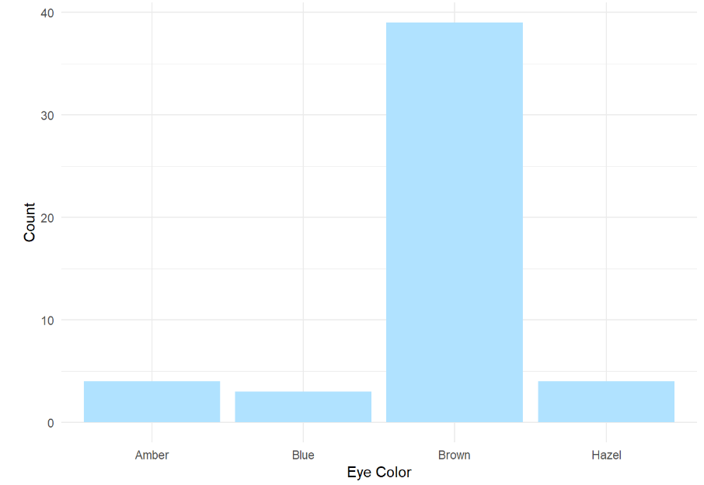
Level 1: Motivation
Eye Color Distribution

Slide 4
Part 1: Connection to Population Change and Density
Step 3: Run Chunk 1
What is required to convert the Percentage Change to a numeric variable?
What is required to convert the 2018 Density to a numeric variable?
Step 4: Run Chunk 2
Notice: \\/(.*)
Step 5: No-Knitter

Slide 5
Part 2: Inclusion of Expert Opinion
Step 1: Selector Gadget Website
Open Source
Chrome Extension Exists
Easy: Drag Link to Bookmark Bar as Webpage Explains
Step 2: Observe the Article on 2018’s Safest and Most Dangerous States
What info could be of use?
Do you agree identification?

Slide 6
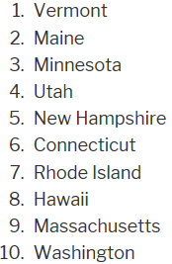
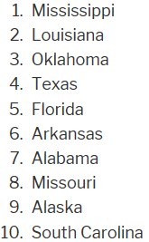
Part 2: Inclusion of Expert Opinion
Step 3: Information of Interest
Safe vs Dangerous
Goal: Scrape this Information into Vectors in R to Create a Table

Slide 7
Part 2: Inclusion of Expert Opinion
Step 4: Identifying CSS Selector
Go to Web Page
Choose SelectorGadget in Bookmark Tab
Locate This Box

Slide 8
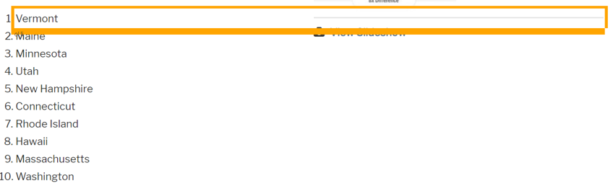
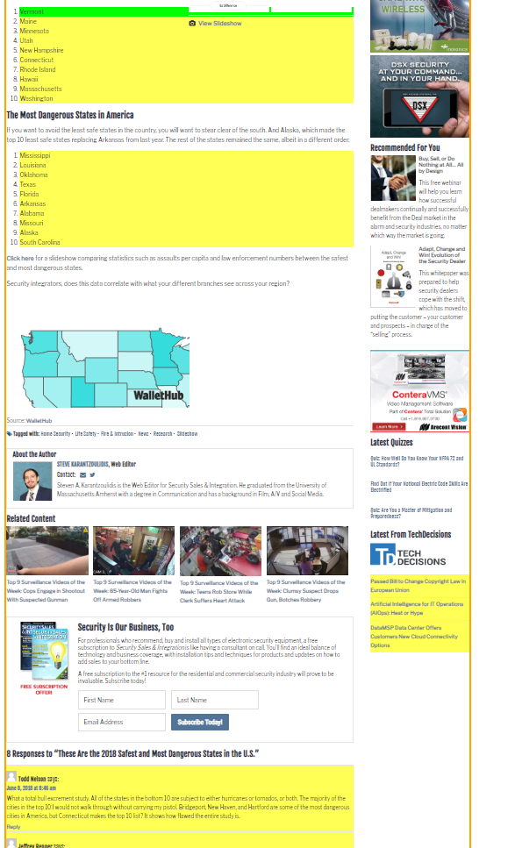
Part 2: Inclusion of Expert Opinion
Step 4: Continued
Find Content You Want
Point and Click
to Select Info
Info We Want is
Highlighted
Info We Don’t
Want, As Well
Hover Over Text We Want

Slide 9
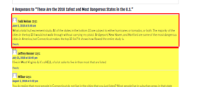
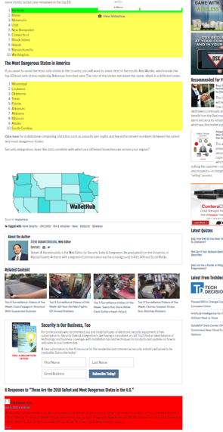
Part 2: Inclusion of Expert Opinion
Step 4: Continued
Find Content You Don’t Want
Point and Click
to Deselect
Locate This Box
Hover Over Text We Don’t Want

Slide 10
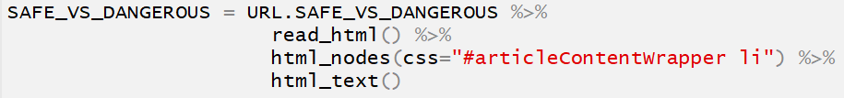
Part 2: Inclusion of Expert Opinion
Step 4: Continued
Locate This Box
Copy CSS Selector
“#articleContentWrapper li”
Step 5: Run Chunk 1
Step 6: Run Chunk 2
What About the Other States?
Step 7: Walk-off Knit

Slide 11
Closing
Disperse and Make Reasonable Decisions

